Slide 1
Multiple Linear Regression
Osama Bin Ajaz
Lecturer
FAST – NU, Main Campus, Karachi
osama.ajaz@nu.edu.pk

Slide 2

Multiple Regression Model
In multiple regression, there are several independent variables and one dependent variable, and the equation is:

Slide 3
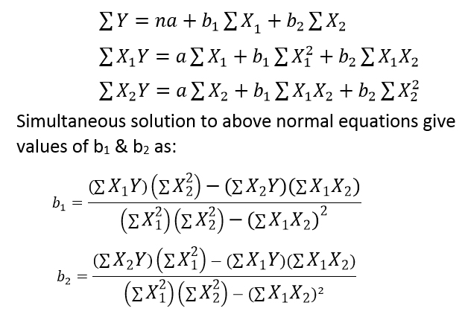
Normal equations for Regression Coefficient for two independent variables

Slide 4
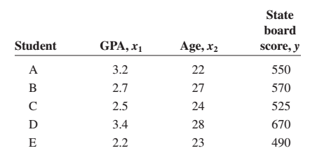
Example # 01
For example, suppose a teacher wishes to see whether there is a relationship between a student’s grade point average, age, and score on the state board examination. The two independent variables are GPA (denoted by x1) and age (denoted by x2).

Slide 5


Example # 01
The multiple regression obtained from the data is:
if a student has a GPA of 3.0 and is 25 years old, the student’s predicted state board score is:

Slide 6
Assumptions for Multiple linear Regression
E (ϵ) = 0
The regression equation is linear in the parameters.
V(ϵ) = σ².
The population distribution of ϵ is normal.
The values for the y variables are independent.
The independent variables are not correlated.

Slide 7
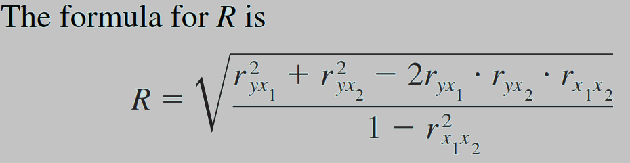
Multiple Correlation (R)
The value of R takes into account all the independent variables.
The value of R can range from 0 to 1; R can never be negative.
The closer to 1, the stronger the relationship; the closer to 0, the weaker the relationship.

Slide 8
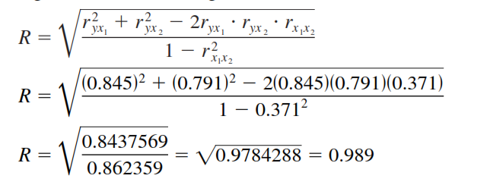
Example # 02
For the data regarding state board scores, find the value of R.

Slide 9
Coefficient of Multiple Determination (R²)
R² is the coefficient of multiple determination, and it is the amount of variation explained by the regression model.

Slide 10

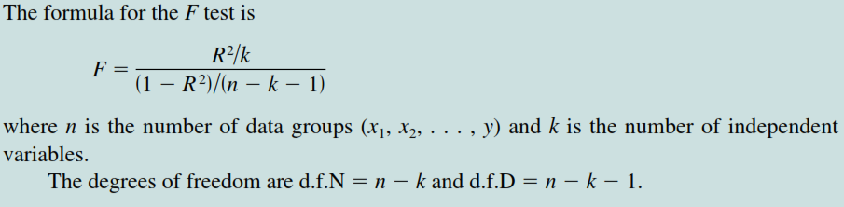
Significance of R
An F test is used to test the significance of R. The hypotheses are

Slide 11
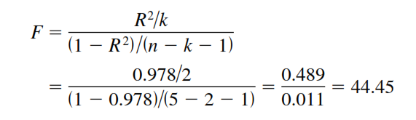
Example # 03
Test the significance of the R obtained in Example 02 at α = 0.05.
The critical value obtained, d.f.N (υ1)= 3, and d.f.D (υ2)=5 - 2 -1 = 2 is 19.16. Hence, the decision is to reject the null hypothesis.

Slide 12
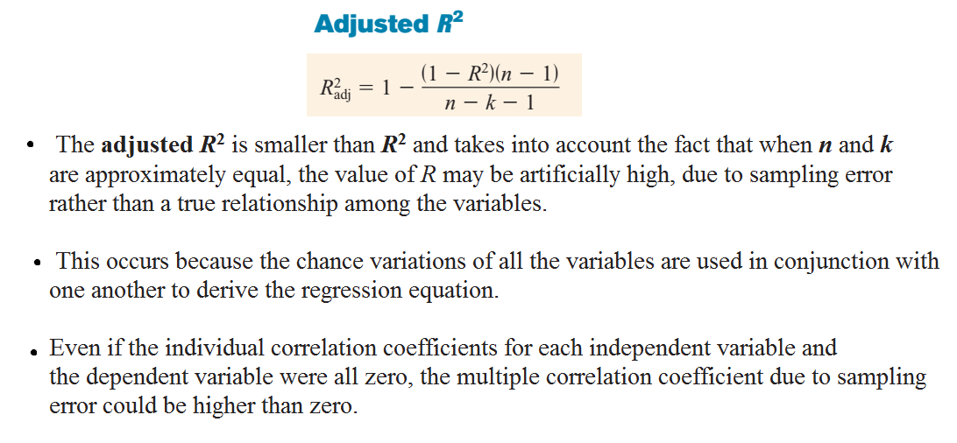

Slide 13
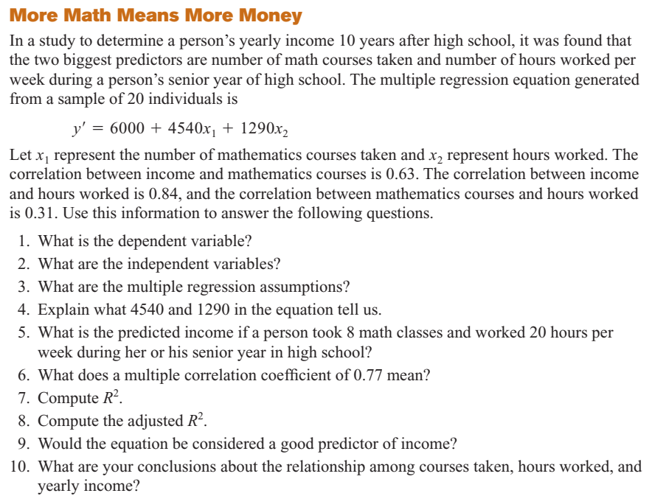
Notes:
Case study

Slide 14
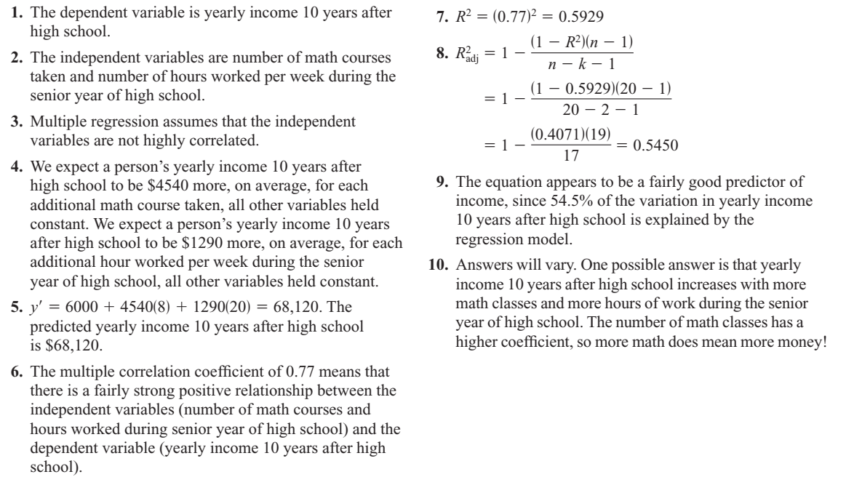

Slide 15
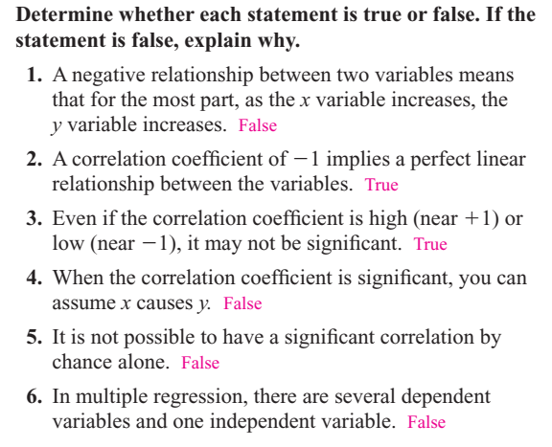

Slide 16
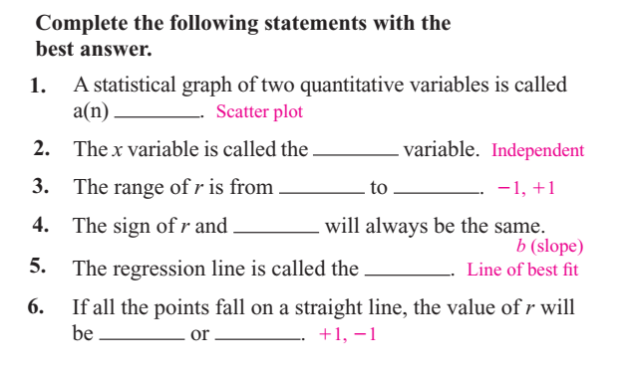

Slide 17
For the next slides do the following

Slide 18
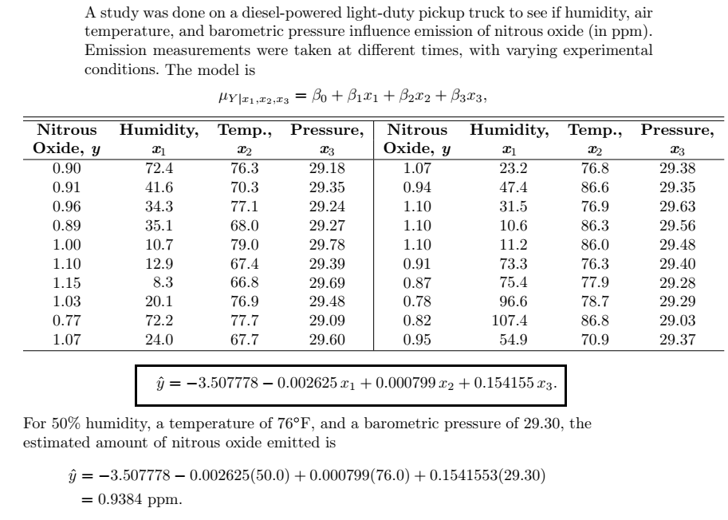
Example: Emission of nitrous oxide

Slide 19
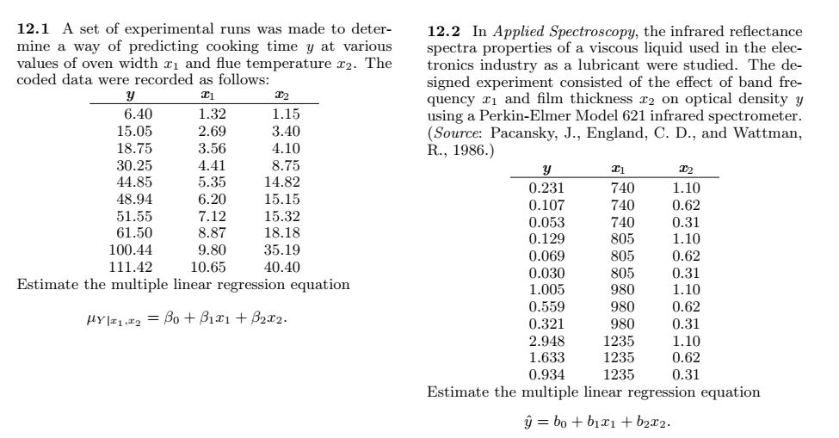
Example:

Slide 20
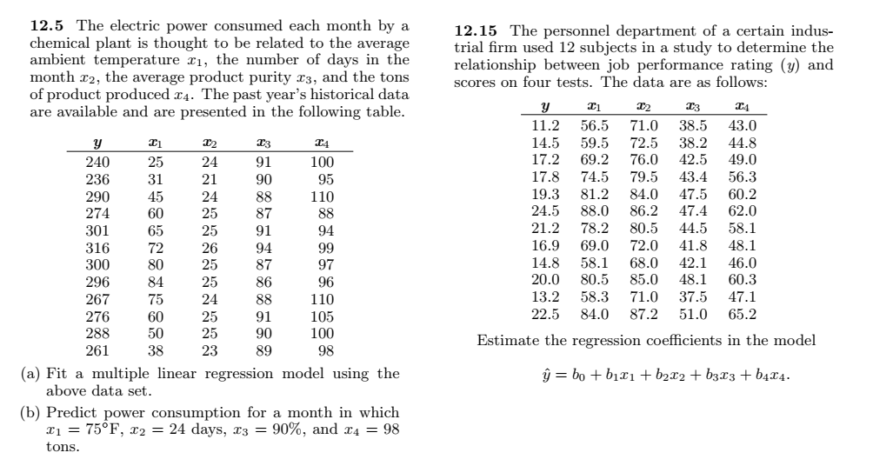

Slide 21
Polynomial regression (optional)

Slide 22
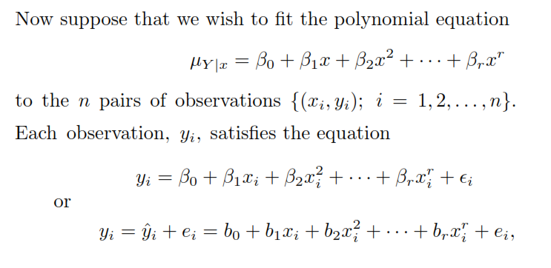
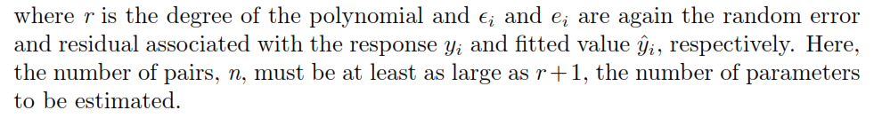
Polynomial Regression

Slide 23

Polynomial Regression (Contd.)
Notice that the polynomial model can be considered a special case of the more general multiple linear regression model, where we
The normal equations assume the same form as those given in previous slides (slides 3 & 4).

Slide 24
Example # 04
Given the data
ﬁt a regression curve of the form and then estimate

Slide 25
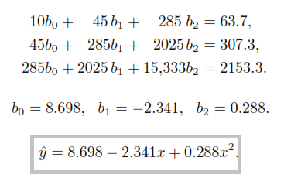

Example # 04 (Contd.)

Slide 26

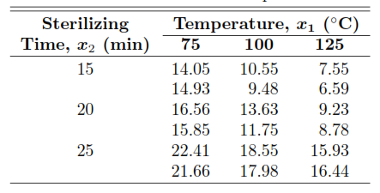
Example # 05
The data given below represent the percent of impurities that resulted for various temperatures and sterilizing times during a reaction associated with the manufacturing of a certain beverage. Estimate the regression coeﬃcients in the polynomial model

Slide 27
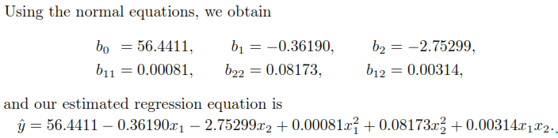
Example # 05 (Contd.)

Slide 28
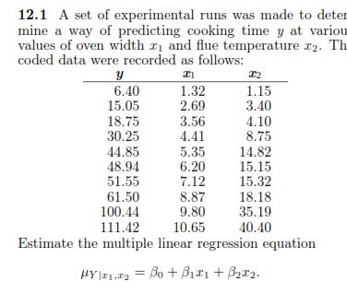
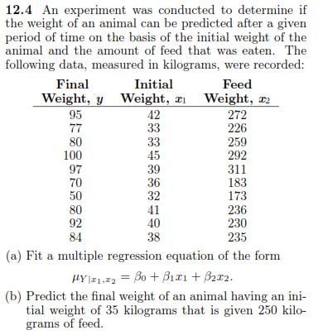
Practice Questions

Slide 29
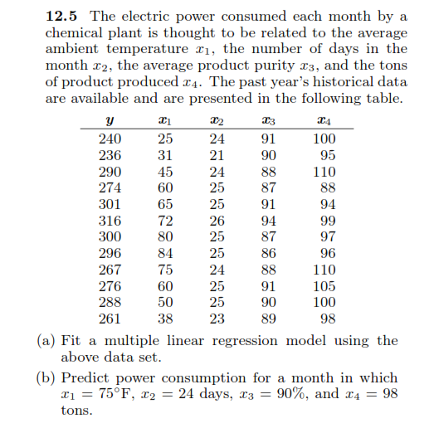
Practice Questions (Contd.)

Slide 30
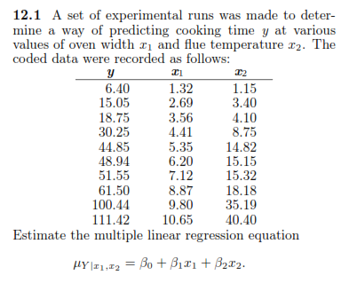
Practice Questions (Contd.)

Slide 31
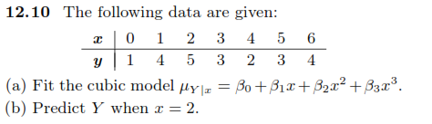
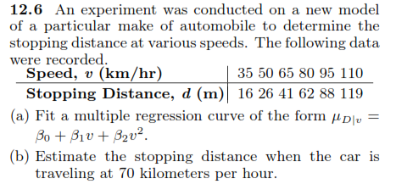
Practice Questions (Contd.)

Slide 32
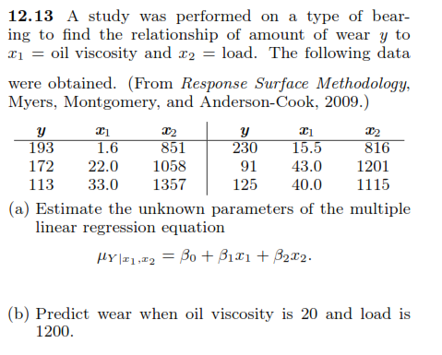
Practice Questions

Slide 33
